Slide 1



Topological Differences Between Big bluestem and Switchgrass
Sara Krznarich
Northern Arizona University
Dr. Nancy Johnson

Slide 2
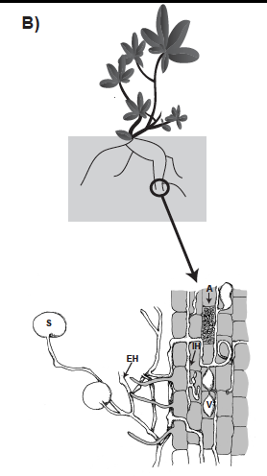

Slide 5
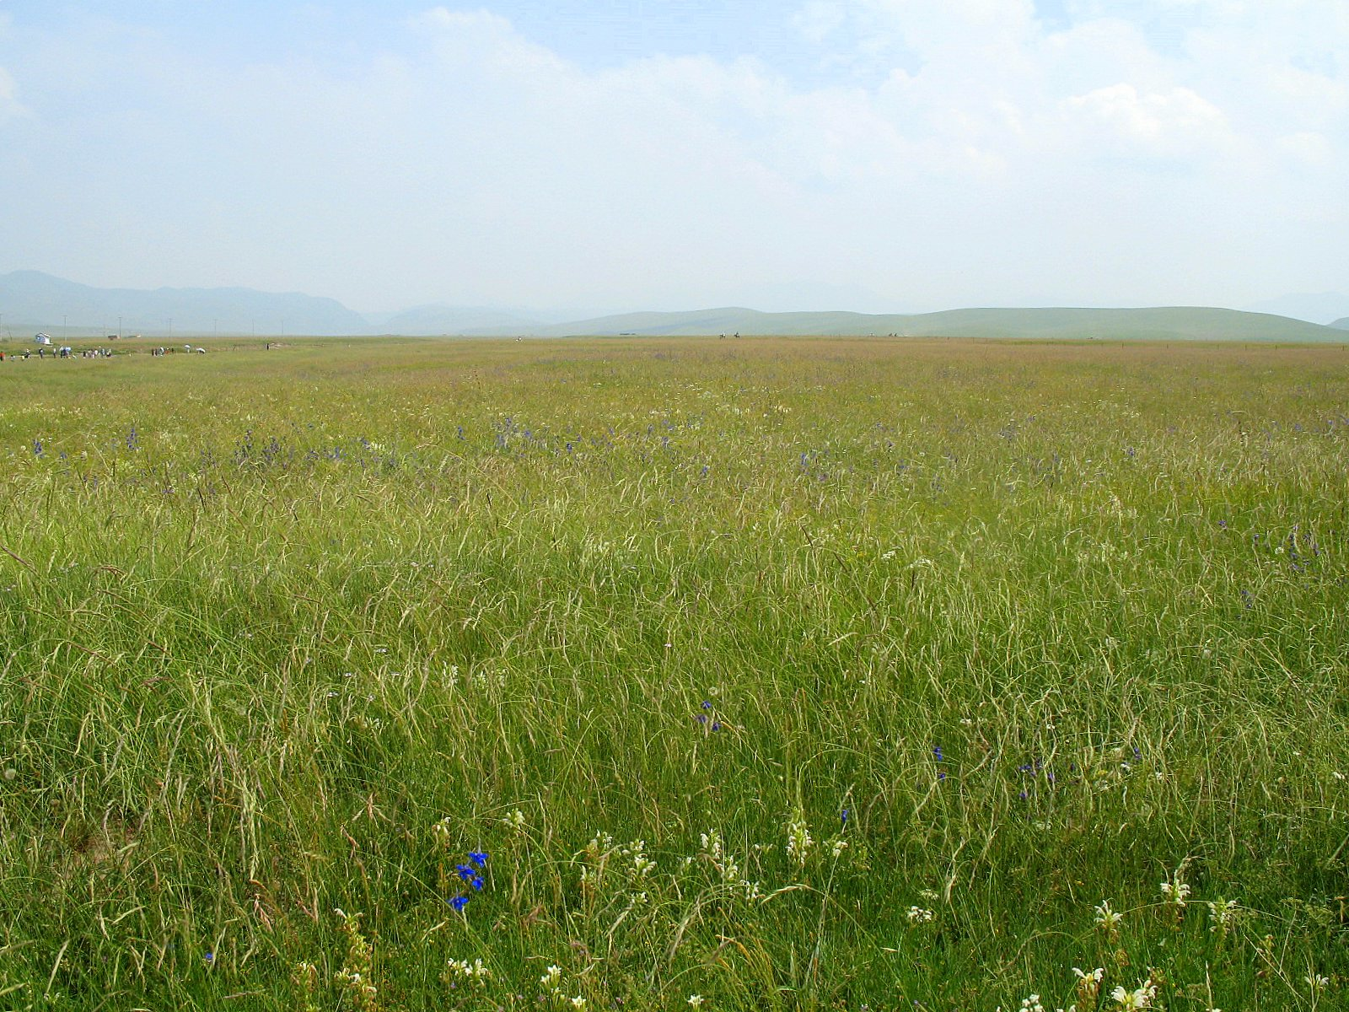
Research Question
Are there differences in the topology and mycorrhizal responses of big bluestem (Andropogon geradii) and switchgrass (Panicum virgatum)?
Photo by Wikimedia Commons
Notes:
‪commons.wikimedia.org1600 × 1200Search by image
‪File:Prairie en Chine du nord.jpg‬

Slide 6
Purpose
Compare plant adaptations to obtain nutrients
Photo by Wikimedia Commons
Notes:
‪commons.wikimedia.org1600 × 1200Search by image
‪File:Prairie en Chine du nord.jpg‬

Slide 7
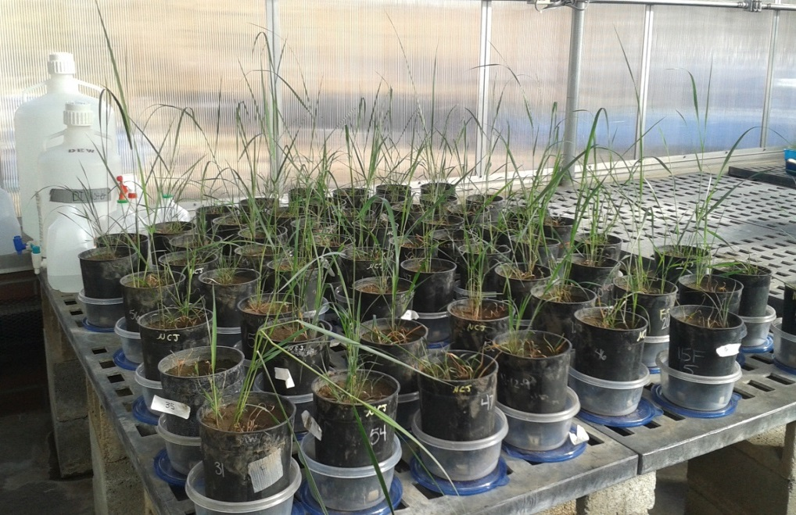
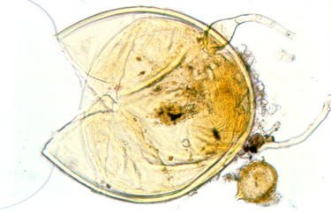
Experimental Design
Factorial greenhouse experiment
  2 grass species: Big bluestem and Switchgrass
  2 mycorrhizal fungi: Gigaspora and Glomus
Photo by Nancy Johnson

Slide 8
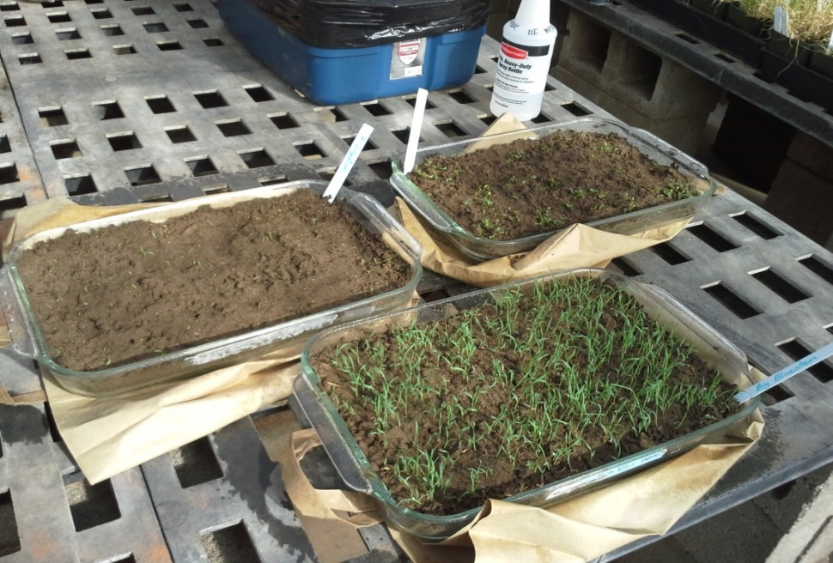
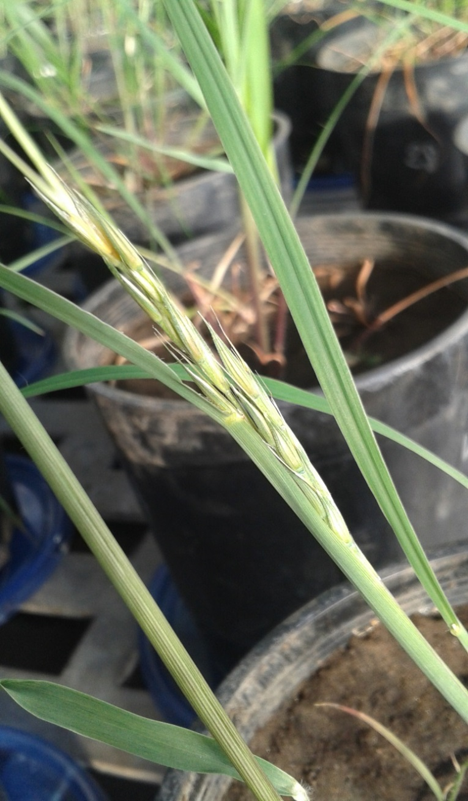
Experimental set-up
Photo by Nancy Johnson

Slide 9
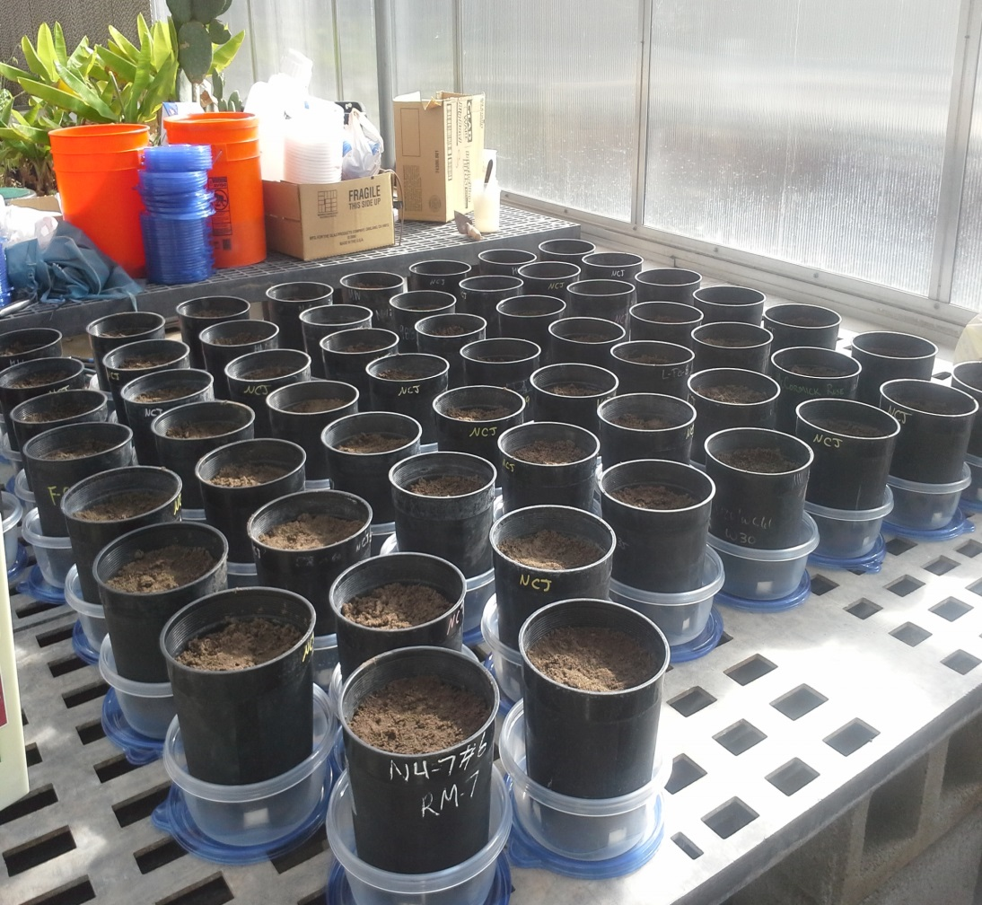
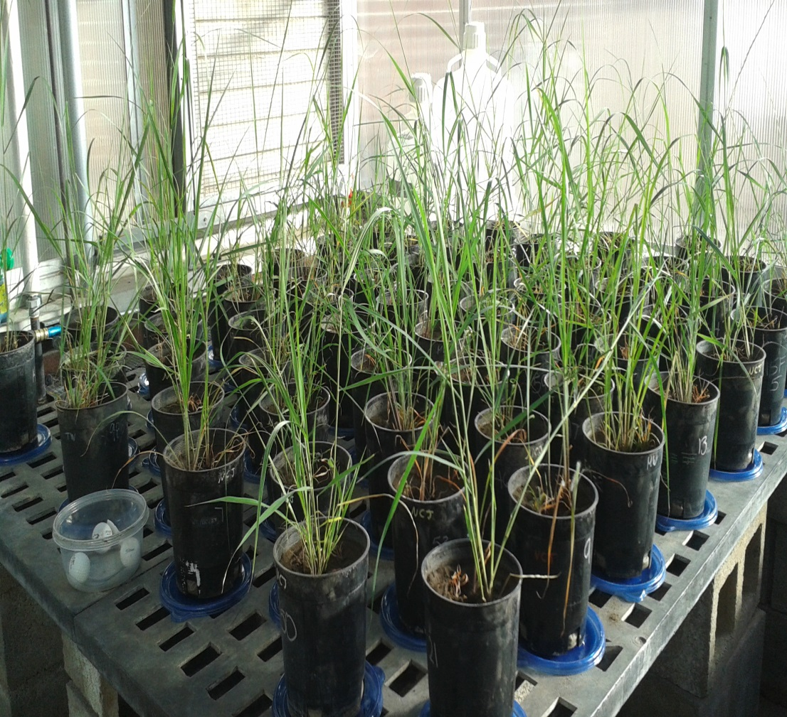
Experimental set-up
0 months
4 months

Slide 10
Analysis: Computer Software
WinRhizo
  Root topology analysis
JMP
  Surface area
  Root length
  Specific root length (length/weight)

Slide 11
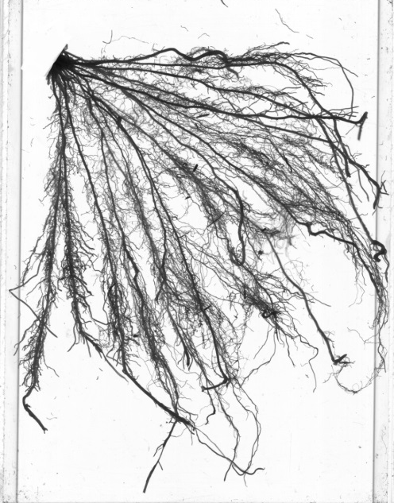


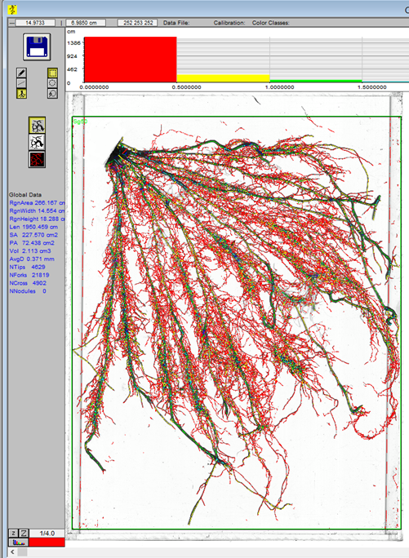
Analysis: WinRhizo

Slide 12
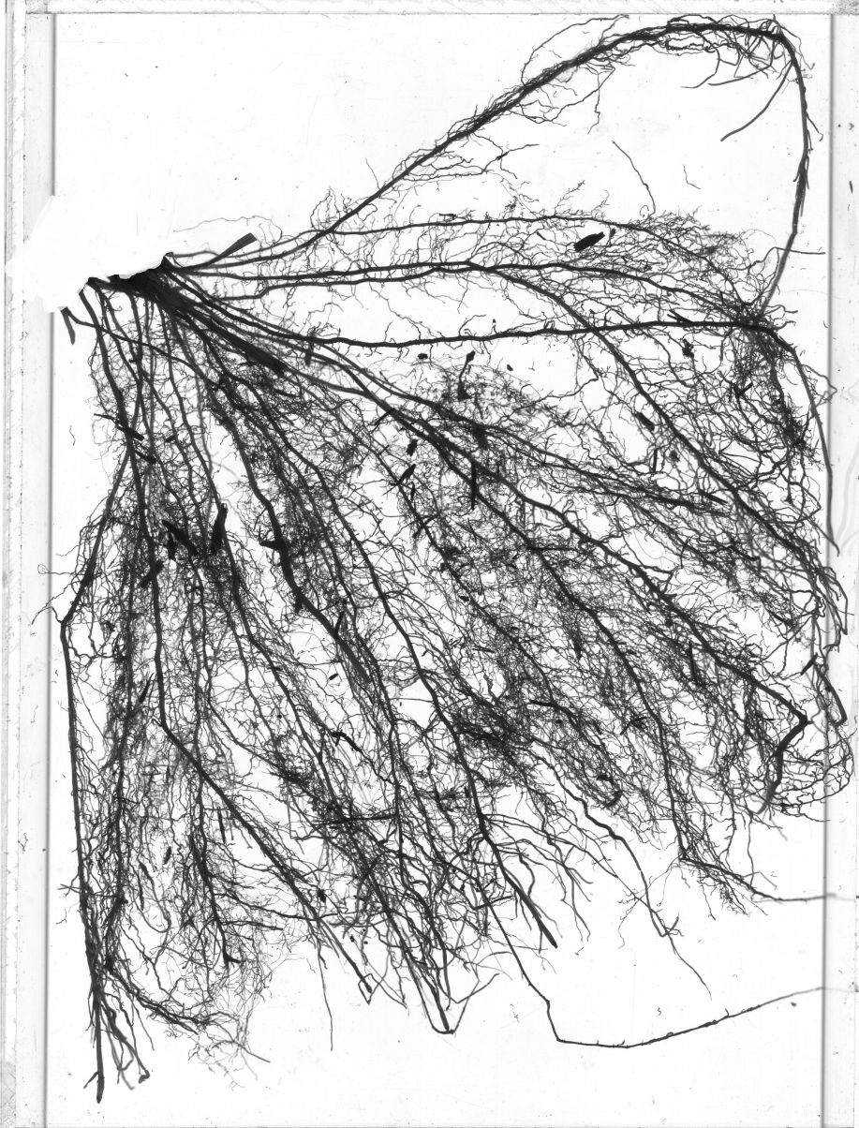
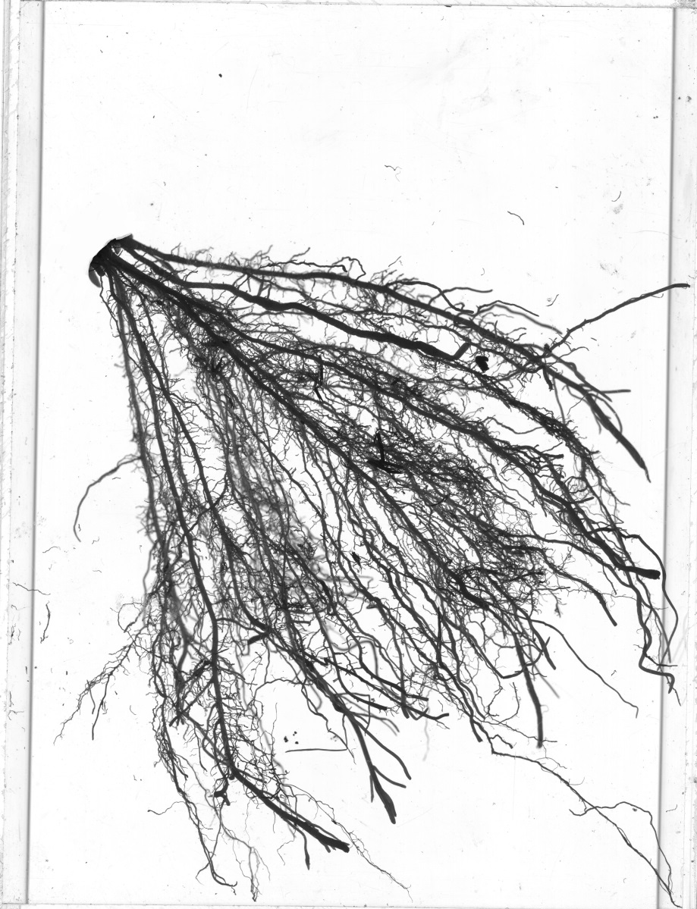
Analysis: WinRhizo
Big bluestem
Switchgrass

Slide 13
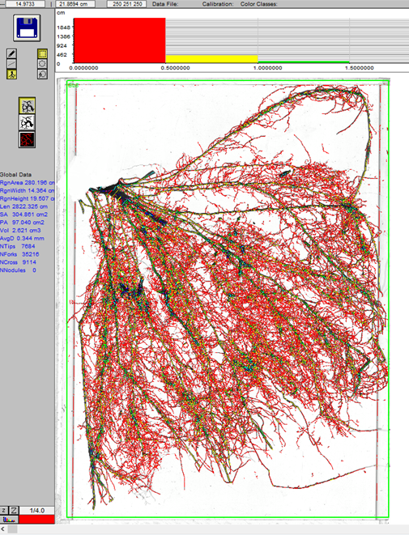
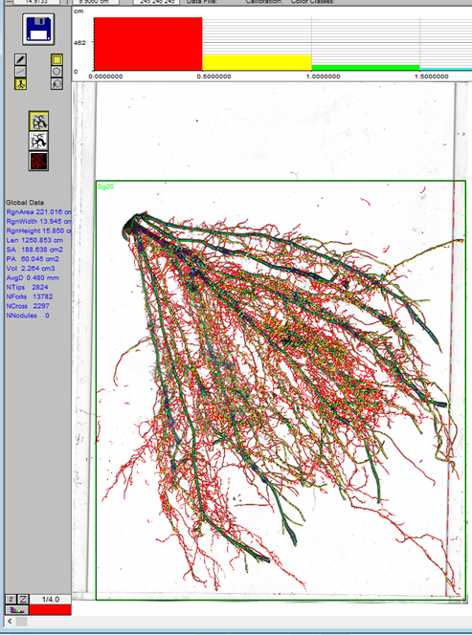
Analysis: WinRhizo
Big bluestem
Switchgrass

Slide 14
Conclusion
Mycorrhizal treatment: unsuccessful
Surface area: not significantly different
Total root length and specific root length differed significantly
  Big bluestem > Switchgrass
Different strategies for nutrient uptake

Slide 15
Acknowledgements
Dr. Nancy Johnson
Northern Arizona University Space Grant Program
Arizona Space Grant Consortium

Slide 16
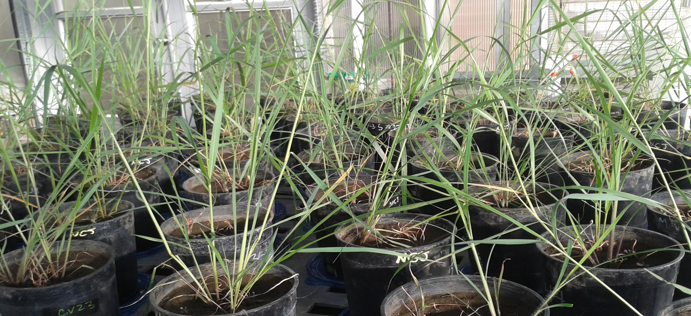
Any Questions?

